Slide 1
NYC Fire Related incident Exploration
Andy Gomez
Notes:
Sr. Support Specialist in RightFax, under Clinical Support Ops.

Slide 2
iNTRODUCTION
The Fire Department of the City of New York (FDNY) is the largest Fire Department in the United States.
It is recognized as the world's busiest and most highly skilled emergency response agency.
FDNY not only responds to more than a million emergencies every year; they also prevent emergencies by educating the public in fire, life safety, disaster preparedness, along with enforcing public safety codes.
Notes:
I decided to do my capstone analysis on this data set because an agency with such a universally renowned reputation, deserves to be investigated.

Slide 3
Data Information
The dataset contains information on investigations by the Bureau of Fire Investigations (BFI) and contains only closed or completed cases.
The Fire Department of New York City (FDNY) is the agency that owns/updates the dataset.
The dataset contains 53, 741 rows and 10 columns.
It was created June 22, 2021, and is updated annually. It contains data going back to 2016.
This data was last updated May 09, 2024.
Notes:
Many of the data bases I reviewed had limited historic data or were updated over a year ago.
I found this dataset to be a reliable source, seeing that it was recently updated in May of this year and that it contained data going back as far as 2016.

Slide 4
Research Questions
What year(s) had the highest / lowest count of investigations?
Did Covid influence the data in anyway?
Which borough(s) had the highest / lowest count of investigations?
Which was the most common incident type in the borough with the highest number of cases?
Of the boroughs with the highest number of cases, which community district had the highest count of investigations?

Slide 5
Methodologies
Libraries: I used Pandas and Seaborn.
Data Exploration
Used statistical functions to review the rows of data.
Subset data to only include the columns or information I needed.
Used functions such as GroupBy to view data for certain boroughs and community districts.
Data Cleaning
Renamed columns for uniformity
Removed null values only from columns where the data could be affected by such values.
Data Visualization
Used Countplot to visualize the Investigations by year and borough.
Used Bar plot to visualize the information for the community districts.
Notes:
Libraries - I added multiple libraries to my workbook, as I was unsure what I was going to need to clean and visualize the data, but only used Pandas and Seaborn.
Data Exploration - I used statistical functions such as count, subset data to only include the columns related to my analysis, used functions to group data by common information such as borough.
Data Cleaning – I cleaned the column headers by removing underscores to provide uniformity, removed non-standard null values from certain columns
Data Visualization – I tried several visualizations and decided the Countplot and Bar plot best fit my data needs.

Slide 6
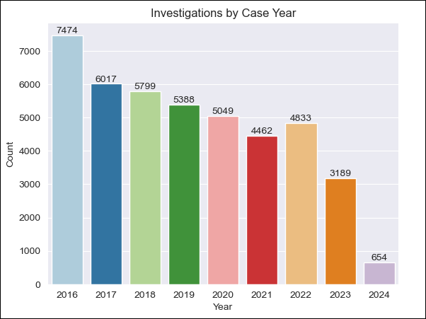
Findings BY YEAR
The year with the highest count of investigations was 2016.
The year with the lowest count of investigations was 2023.
Notes:
As we are still in 2024 and investigations are ongoing, I am focusing on data from the previous years.
I did not remove data for the current year because I wanted to mitigate bias. By removing this information, my data could have been needlessly altered.

Slide 7
Findings BY YEAR - Ties to covid
The investigations decrease by over 500 cases from 2020 to 2021, during the peak of Covid outbreak.
This is the second highest chronological decrease in cases since 2016 to 2017, which decreased by over 1,400 cases.
Notes:
It is important to note there is a decrease of approximately 587 cases from 2020 to 2021.
This is the second highest chronological decrease in investigations, since 2016 to 2017 which dropped by 1,457.
Due to this, I did further research on covid peak numbers and how NYC compared to other cities.

Slide 8
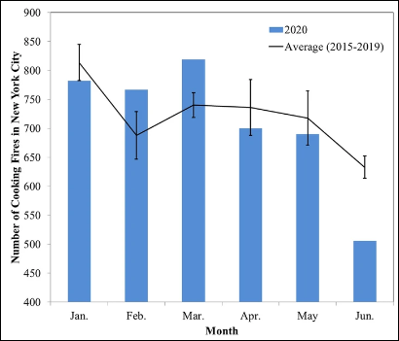
FINDINGS BY YEAR - TIES TO COVID Studies
According to a study by the National Library of Medicine (Estimating COVID-19 Hospitalizations in the United States With Surveillance Data Using a Bayesian Hierarchical Model: Modeling Study), the largest peak in covid reported cases in NYC were from 2020 – 2021.
In addition, a study performed by the National Institute of Standards and Technology (The influence of covid-19 stay at home measures on fire statistics sampled from New York city, London, San Francisco, and Tokyo), the number of cooking fires increased in other cities like San Francisco and Tokyo, while it did not increase in New York city.
These two studies, in conjunction with my analysis, suggests that Covid influenced the decrease of investigations due to the quarantine restrictions in 2020 – 2021 compared to the previous years.
Notes:
According to the National Library of Medicine, the largest peak in covid reported cases in NYC were from 2020 – 2021.
According to the National Institute of Standards and Technology NYC did not increase in

Slide 9
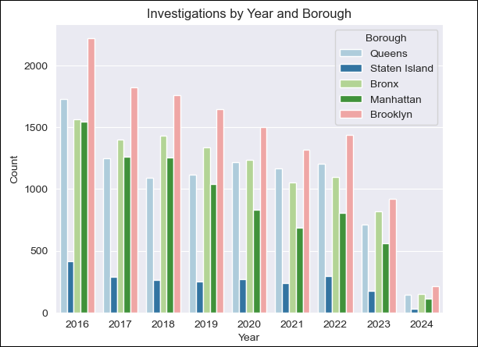
Findings by Borough
Brooklyn is the borough with the highest count of investigations.
Staten Island is the borough with the lowest count of investigations.
*
Notes:
Since Brooklyn numbers were so disparate compared to other boroughs every year from 2016 – 2023, I wanted to further research the data for Brooklyn.
I wanted to find out which Community District had the highest counts of investigations, as this would serve as part of my recommendations.

Slide 10
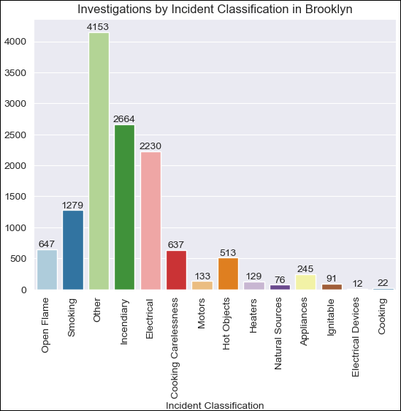
Findings by borough - Brooklyn
The highest number of incidents occurred under the “Other” category, which this dataset did not provide any details for.
Second is the Incendiary classification, third is Electrical incidents, fourth is Smoking Incidents, followed by Open Flame.
Notes:
The reason I did not remove data listed as “Other” is because I wanted to mitigate bias. By removing this information, my data could have been needlessly altered.
Incendiary classification means the fires were deliberately ignited under circumstances which a person knows the fire should not be ignited.
Electrical classification means the fires were caused by electrical fault or malfunction.
Smoking classification refers to fires started by carelessly discarded or abandoned smoking materials such as cigarette butts/ashes.
Open flame classification refers to fires started by a flame such as a candle that is not enclosed.

Slide 11
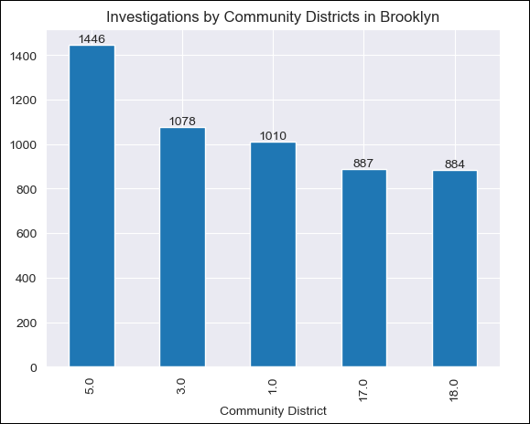
Findings by borough - Brooklyn
The district with the highest number of cases in Brooklyn was Community District 5, and it was followed by district 3, district 1, district 17, and district 18.
Notes:
Here we see that Community district 5 had the highest number of cases.
After analyzing the community district, I realized I did not have the actual district information, so on to google I went.

Slide 12
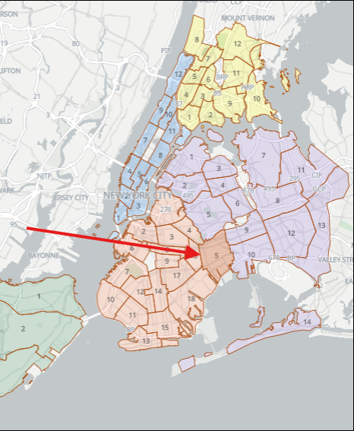
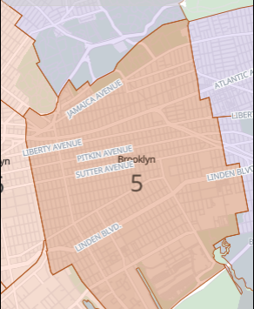
Findings by borough - Brooklyn
The specific district information was not provided in the data set; however, the NYC Department of City Planning’s Community District Profiles website provided geographical information for the districts in all boroughs.
Notes:
I found the NYC Department of City Planning’s Community District Profiles website,
This website is full of information such as population by age, gender, race, foreign born population, crime, etc.
I was able to obtain geographical information such as street names in the district to obtained a geographic location.

Slide 13
Conclusions
The year 2016 had the highest number of investigations, followed by 2017. There has been a consistent decrease in the count of investigations since 2017.
There is a correlation between the decrease in investigations during the peak of covid during 2020 - 2021, with studies supporting this analysis.
Brooklyn had the highest count of investigations and Staten Island had the lowest of all the boroughs.
The most common incident types are Incendiary, Electrical, Smoking, and Open Flame.
In Brooklyn, Community District 5, had the highest count of investigations. This district includes portions of Jamaica Ave, Liberty Ave, Pitkin Ave, Sutter Ave, and Linden Blvd.

Slide 14
Recommendations
The community district with the highest number of investigations is district 5. Since the FDNY attempts to reduce emergencies by educating the public, it would be beneficial if more resources were spent in this specific district.
It would be beneficial to review data from the districts in Staten island that have lower counts, seeing that Staten Island placed last in the counts of investigations. It would be helpful to learn what type of public education is provided in these boroughs that may help in boroughs that did not perform as well.

Slide 15
References / Data Sources
Data: Bureau of Fire Investigations - Fire Causes | NYC Open Data (cityofnewyork.us)
Study 1: The Influence of COVID-19 Stay at Home Measures on Fire Statistics Sampled from New York City, London, San Francisco, and Tokyo | NIST
Study 2: Estimating COVID-19 Hospitalizations in the United States With Surveillance Data Using a Bayesian Hierarchical Model: Modeling Study - PMC (nih.gov)
Resource: NYC Community Districts - NYC Planning | Community Profiles
Resource: overview (NYC.gov)
Resource: Layout 1 (NYC.gov)
Notes:
REMINDER!!!
Last slide – Do not close presentation yet.
Ask for questions first. If none, then stop sharing.

